Slide 1

Early Detection of Melanoma Skin Cancer by Using Deep Learning
Arif Mertaslan
Hazar Özyağcı
S. Ayberk Kılıçaslan
Assoc.Prof.
Zerrin Işık

Slide 2
Contents
Melanoma Skin Cancer
Widespread Effect
Originality
Mobile Application Demo
Application System Requirements
Image Pre-processing
Deep Learning Models (Inception v3)
Deep Learning Models (MobileNet)
Model Optimization
Model Test Results
Goal of Project
Feasibility and Conclusion
Tools and Libraries for Mobile Application

Slide 3
Melanoma Skin Cancer
Average 55.000 deaths per year.
0.7 percent of total cancer deaths.

Slide 4
Goal of Project
Creating a deep learning model that can diagnose melanoma skin cancer with high accuracy by using ISIC 2017 data set.
The aim of the developed mobile application is to make the early diagnosis of Melanoma skin cancer more common.

Slide 5
Originality
A deep neural network model that predicts melanoma skin cancer, where the user can more easily detect the result with a given diagnostic percentage.
The ability of the deep network model to work directly on the mobile phone operating system, without the need for any Internet connection.
Using images from both the camera and the photo gallery within the mobile application.
Ability to adjust the size of the image in the application.

Slide 6
Widespread Effect
By diagnosing melanoma skin cancer with 86% accuracy via the mobile application, it is possible to ensure that individuals apply for a doctor's examination in a timely manner.
Reducing, and preventing melanoma skin cancer-related deaths in society with the help of early diagnosis.

Slide 7
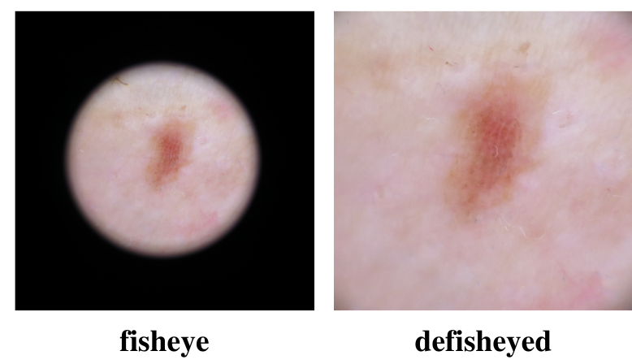
Image Pre-processing
After the useless data for model training were cleaned manually, the fish-eye images were translated into their normal versions.

Slide 8
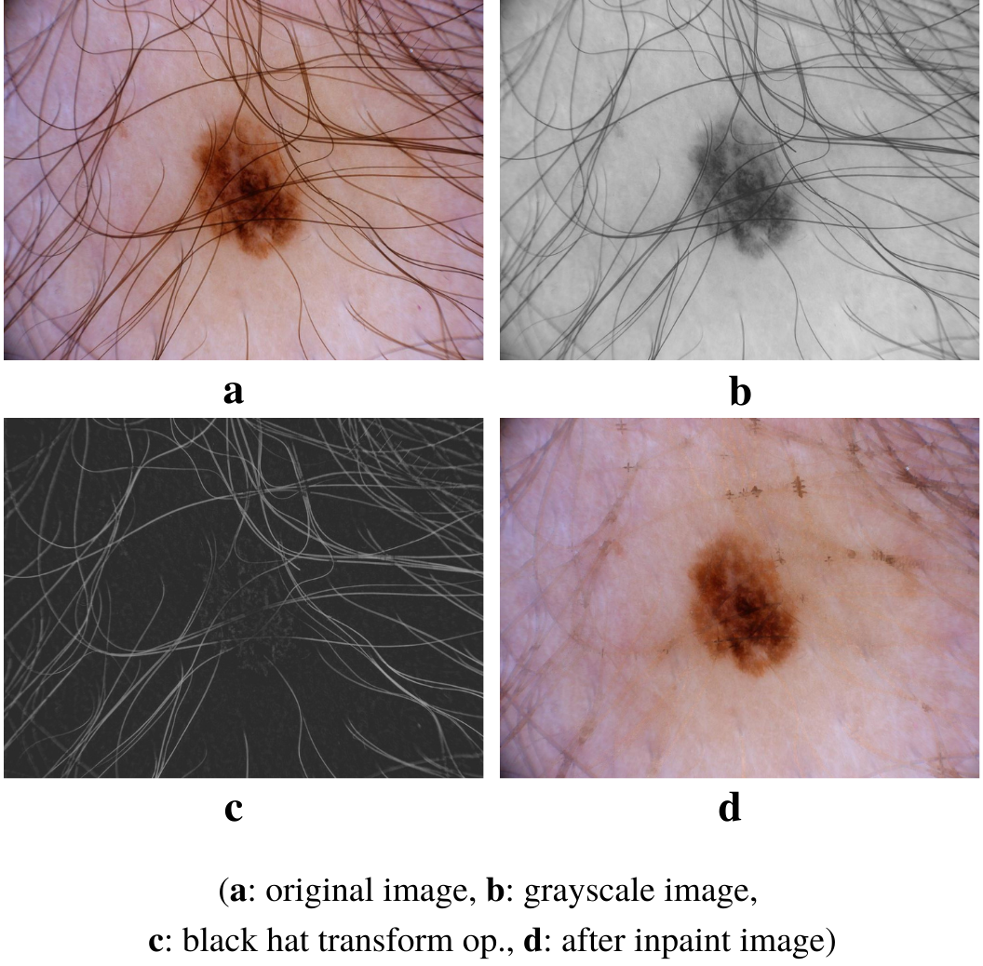
Image Pre-processing
The black hairs in the images were removed with the help of the OpenCV library.

Slide 9
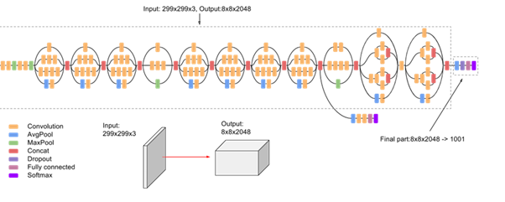
Deep Learning Models (Inception v3)

Slide 10
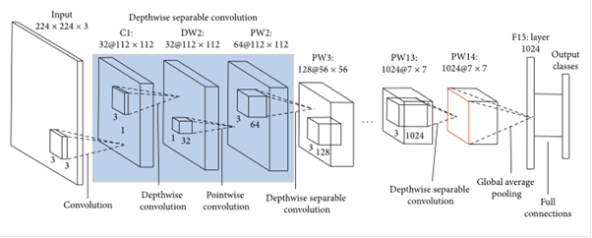
Deep Learning Models (MobileNet)

Slide 11
Model Optimization
In order to find the optimal values of these parameters, the Bayesian Search optimization was performed.
MobileNet
Inception v3
Number of FCC layers: 1
Number of Dense: 91
Learning Rate: 1.3e⁻⁴
Activation Func: Sigmoid
Accuracy: 0.85
Number of FCC layers: 1
Number of Dense: 512
Learning Rate: 8.1e⁻⁵
Activation Func: Sigmoid
Accuracy: 0.864

Slide 12
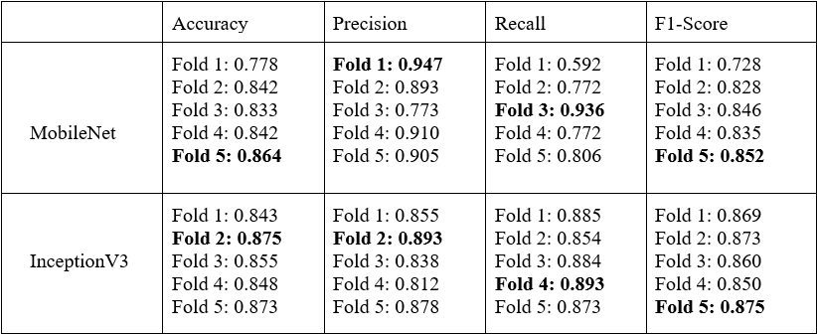
Model Test Results
Although the Inception v3 model performed a little better in accuracy, the operability and speed of the mobile application were considered, and it was decided to use MobileNet.

Slide 13
Tools and Libraries for Mobile Application (IDE, Languages, DataBinding)
The mobile application was developed through Android Studio by using Kotlin language and interface elements were defined by using XML.
The connection between the interface elements and the Kotlin code is provided by using the DataBinding library.

Slide 14
Tools and Libraries for Mobile Application (Intent, CropImage)
The Intent library was used to access the Gallery and the Camera, as well as to provide the transition between screens.
The image editing (cropping, rotating, flipping) page was created with the CropImage library.

Slide 15
Tools and Libraries for Mobile Application (Tensorflow Lite)
The deep learning model, which was previously saved and converted to the tflite extension for mobile-compatible operation, was also read from the asset folder and stored in the ByteBuffer type.
After the model and image were prepared, the image was tested and the result was printed on the screen.

Slide 16
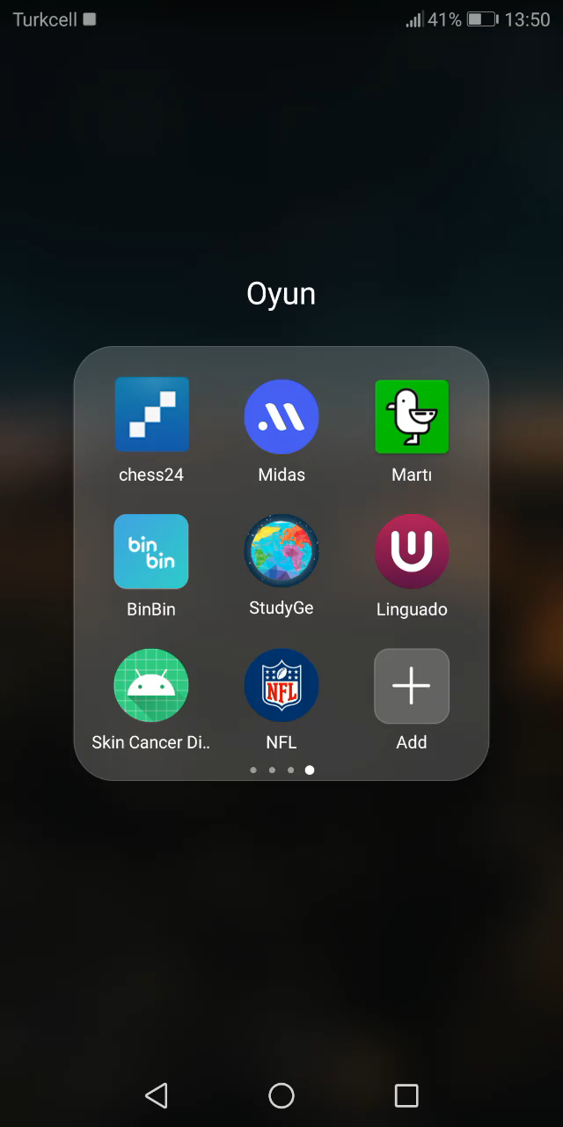
Mobil Application Demo

Slide 17
Mobile Application System Requirements
It works smoothly on devices with Android 5.0 and higher operating system.
There must be at least 60 MB of free space on the device where the application will be used.
There is no internet connection requirement.

Slide 18
Feasibility and Conclusion
The accuracy rate of the model is at the level of 86%, which is a sufficient level of reliability for individuals to have an idea before contacting a specialist.
This model, developed in conjunction with the use of a larger number of high-quality data and more advanced hardware devices, can be used in a medical device that has the ability to diagnose, rather than being an auxiliary application in a hospital setting.

Slide 19
Questions?
Thanks for listening, any question?

